Slide 1
PhpStorm from JetBrains
STEP 1:
Apply for license
Download PhpStorm
STEP 2:
Configure SFTP Connection to Server ( I will walk you through this )
Host: 54.89.223.17
Username: ec2-user (this is same for everyone)
Root path: /var/www/iotnetworking/<yourlastname>
STEP 3:
Clone GitHub Repository
https://github.com/BryanCage/iot_networking
STEP 4:
Open Chrome Browser (Note: Won’t work in FireFox)
https://iotnetworking.iotserver.website/<yourlastname>/
http://iotnetworking.iotserver.website/<yourlastname>/index_unauth_unencrypt.php
Notes:
Download, Install PhpStorm and MQTT.fx
Get PhpStorm SFTP connections configured (they will need .pem file (iotserver_2021.pem) and ip: 54.89.223.17)
Wiring the ESP32 – Connect LED and TMP36 Temperature Sensor
Get TMP36 Temperature Sensor Connected and Outputting Temperature Data
Sketch => ESP32_ADC_Reading_TMP36_TemperatureSensor.ino
Turning LED On and OFF using ESP32
Sketch => LED_Blink_ESP32_Pin5
What is an IoT Platform?
Understanding JSON (node demo) using PhpStorm IDE
Understanding JSON using ESP32
Sketch => Understanding_JSON.ino
Understanding MQTT using ESP32 and MQTT.fx
Sketch => MQTT_Basics_IoTNetworking.ino
Understanding Basics of MQTT using

Slide 2

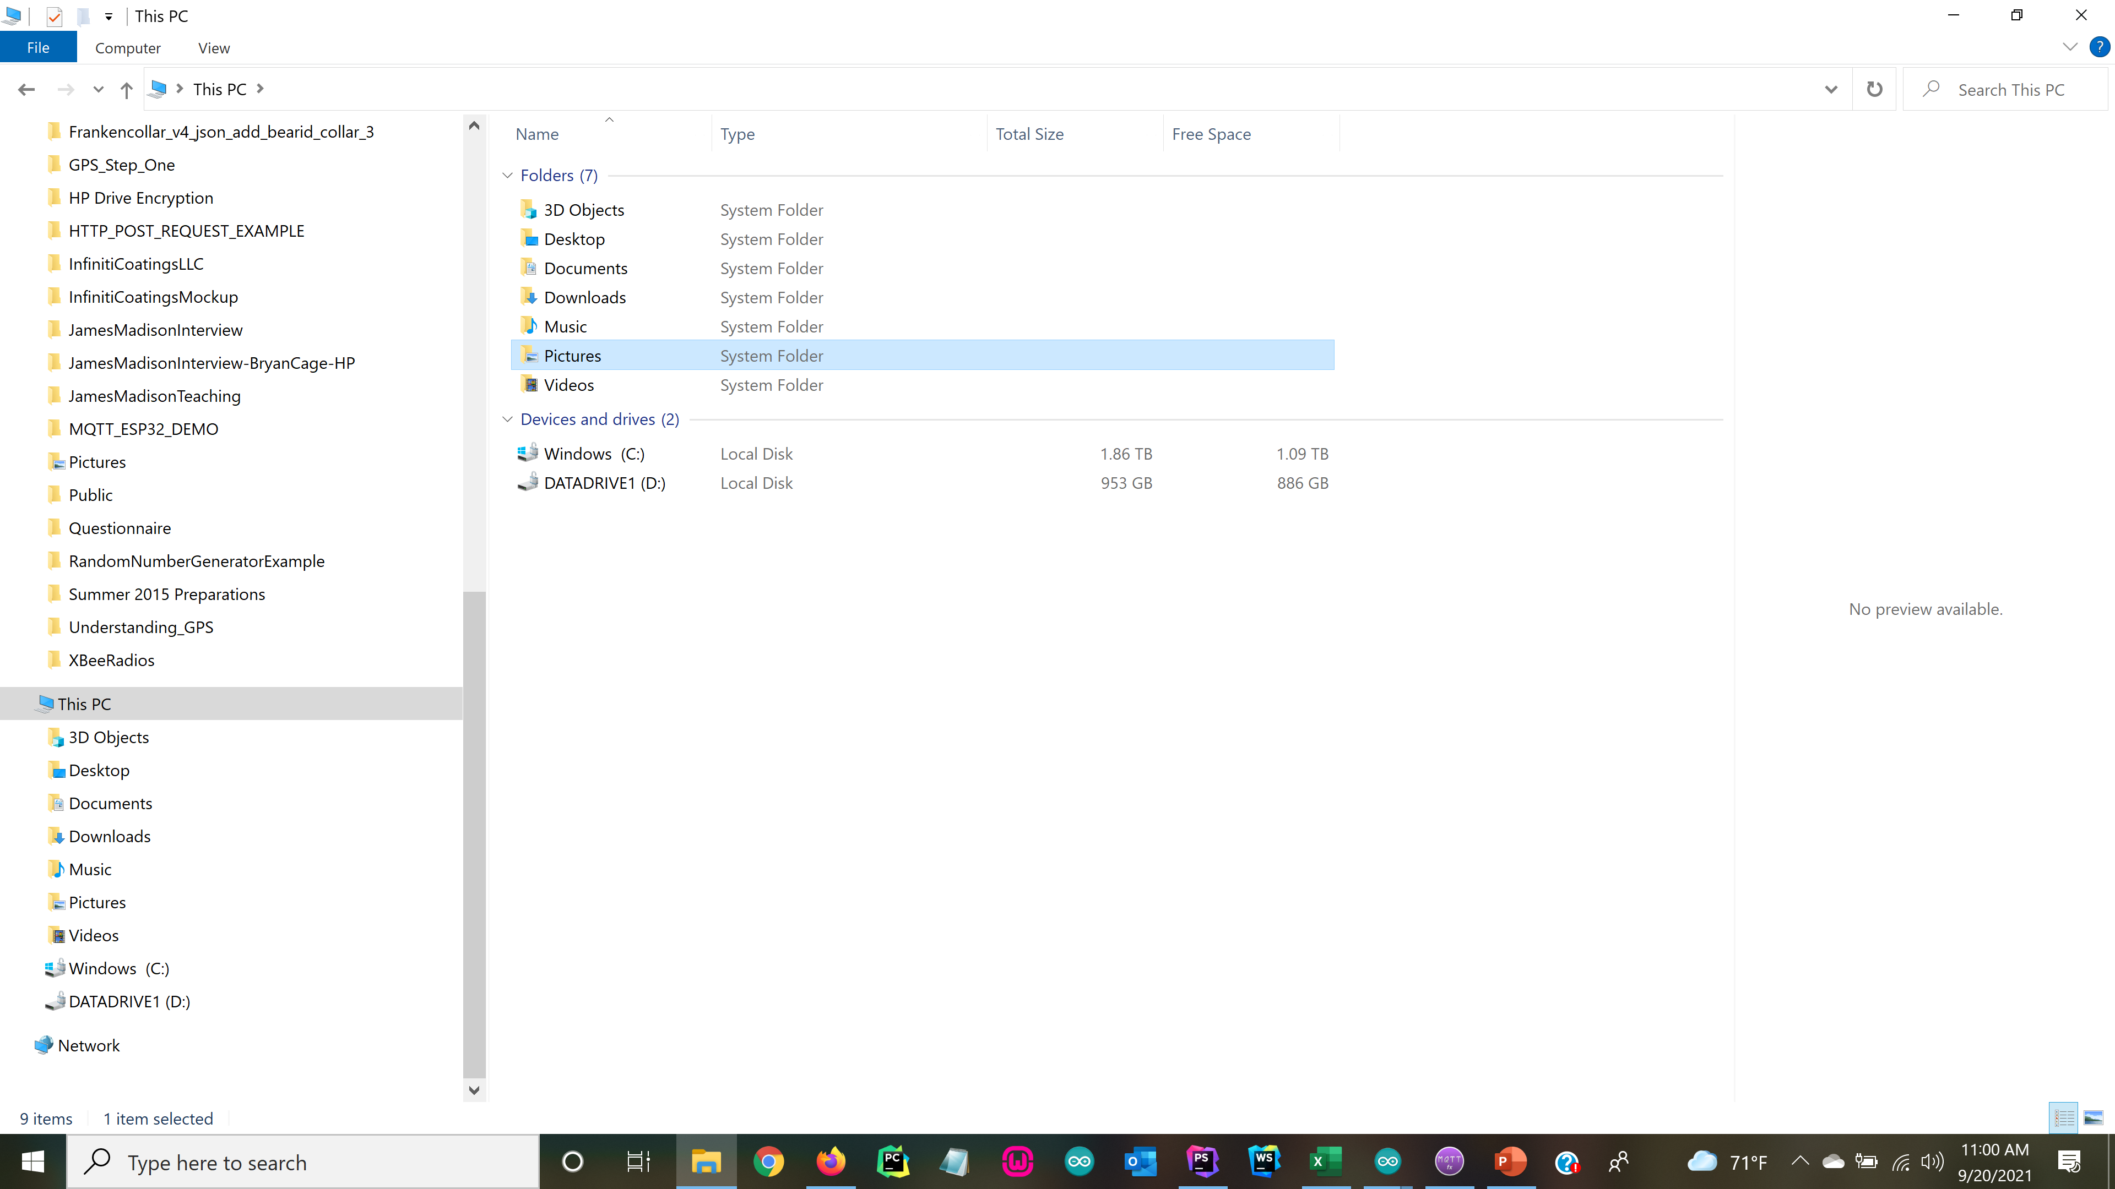
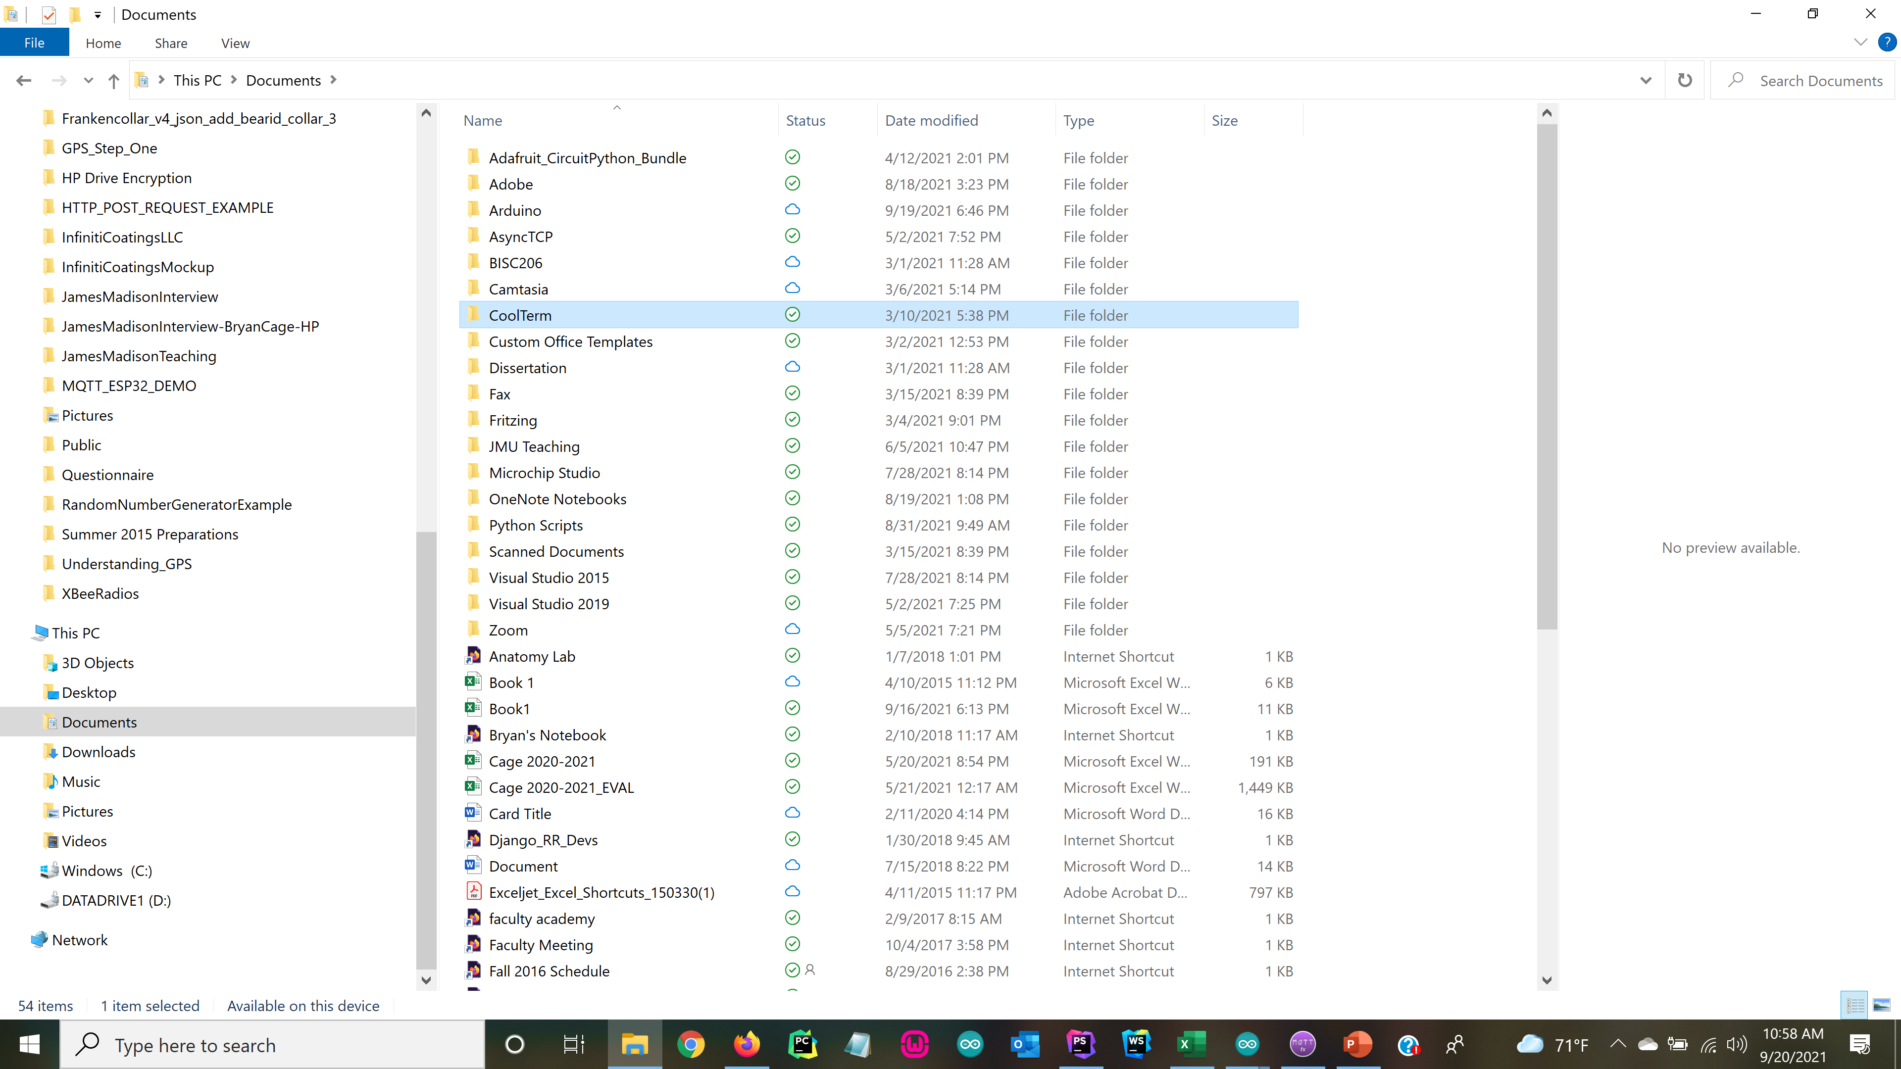
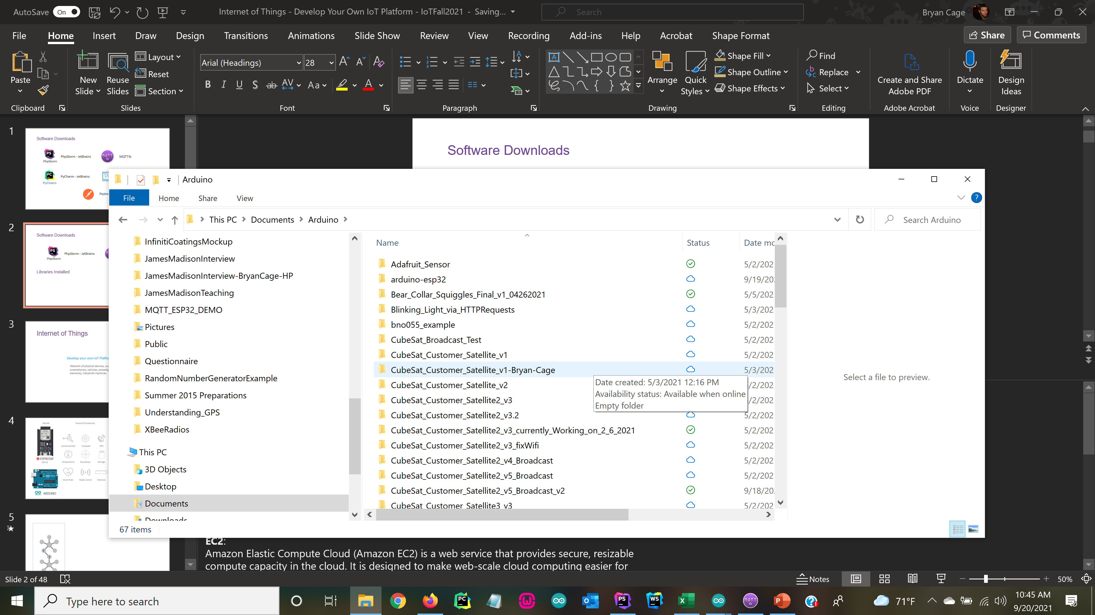
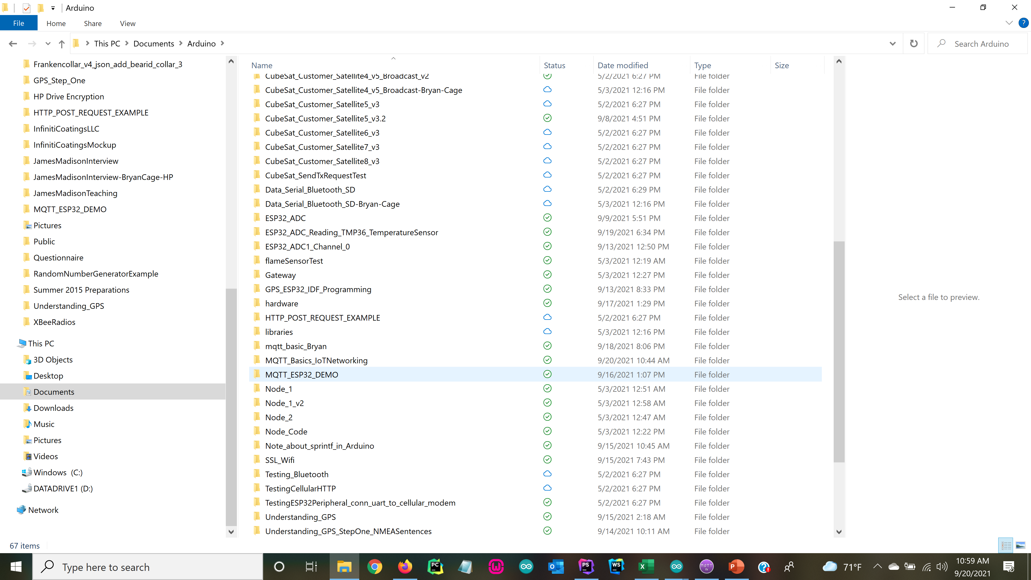
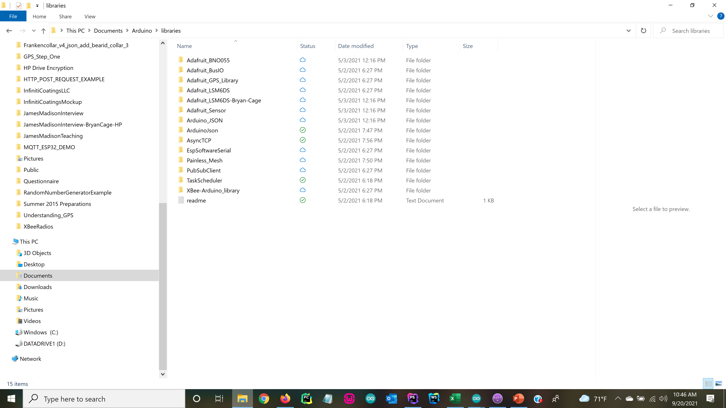
Software Downloads
MQTT.fx
Download MQTT.fx
Libraries Installed
Zip folders for these libraries can be found on SLACK in homework channel
Download, unzip, and place library folders according to directory on left
Documentation for installing Arduino-esp32: https://docs.espressif.com/projects/arduino-esp32/en/latest/installing.html
Notes:
Download, Install PhpStorm and MQTT.fx
Get PhpStorm SFTP connections configured (they will need .pem file (iotserver_2021.pem) and ip: 54.89.223.17)
Wiring the ESP32 – Connect LED and TMP36 Temperature Sensor
Get TMP36 Temperature Sensor Connected and Outputting Temperature Data
Sketch => ESP32_ADC_Reading_TMP36_TemperatureSensor.ino
Turning LED On and OFF using ESP32
Sketch => LED_Blink_ESP32_Pin5
What is an IoT Platform?
Understanding JSON (node demo) using PhpStorm IDE
Understanding JSON using ESP32
Sketch => Understanding_JSON.ino
Understanding MQTT using ESP32 and MQTT.fx
Sketch => MQTT_Basics_IoTNetworking.ino
Understanding Basics of MQTT using

Slide 3
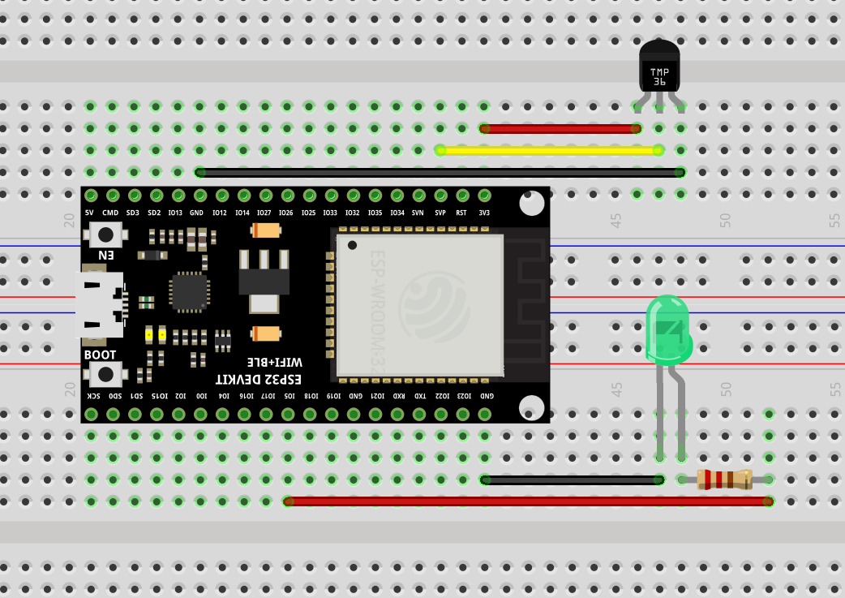
GPIO36 (VP)
-
+
220 Ohm
GPIO5
Notes:
LED_Blink_ESP_Pin5
ESP32_ADC_Reading_TMP36_TemperatureSensor
Understanding_JSON.ino
MQTT_Basics_IoTNetworking.ino

Slide 4
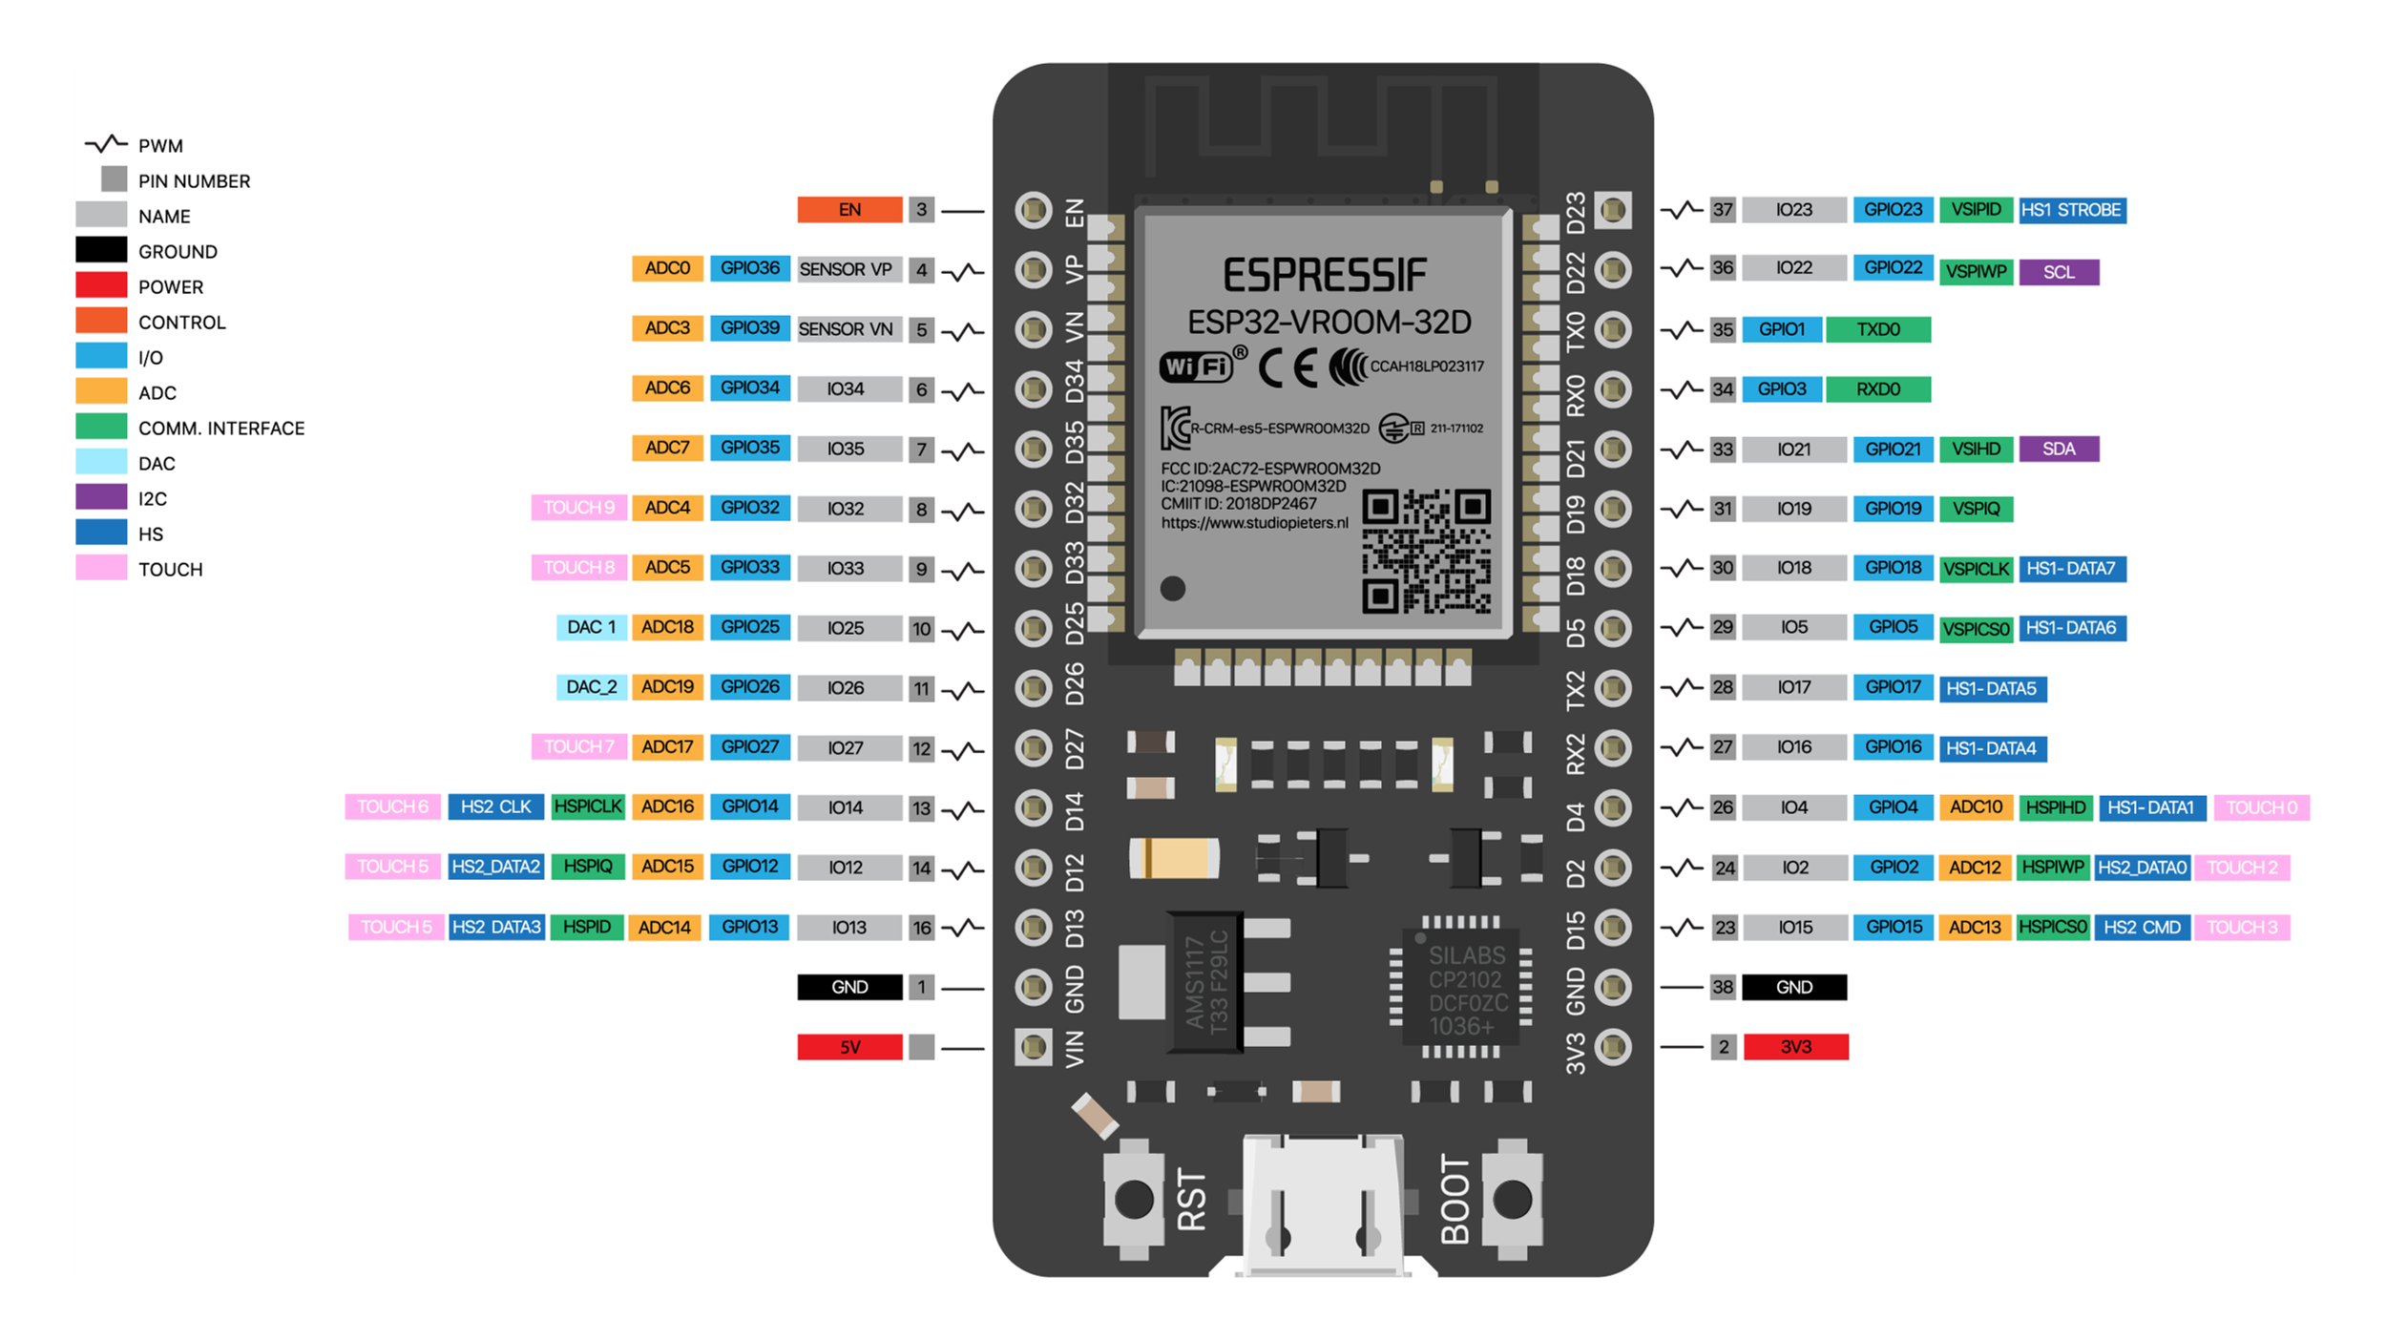

Slide 5
Run the following Scripts to test LED connection and TMP36:
Compile, upload, and run => LED_Blink_ESP_Pin5.ino
Compile, upload and run => ESP32_ADC_Reading_TMP36_TemperatureSensor.ino
This requires the <driver/adc.h>.
If you get an error involving the #include <driver/adc.h> then here is an online link to
the ESP-IDF Tools Installer: ESP-IDF Introduction and Installation

Slide 6
Internet of Things
Develop your own IoT Platform
Network of physical devices, such as appliances, smartphones, vehicles, streetlights, infrastructure elements, industrial machines
Notes:
The Internet of Things is the network of physical devices, such as appliances, smartphones, vehicles, streetlights, infrastructure elements, industrial machines

Slide 7
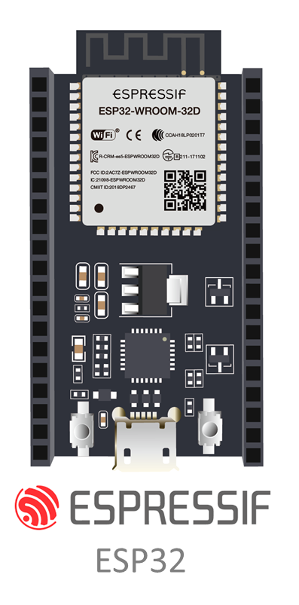

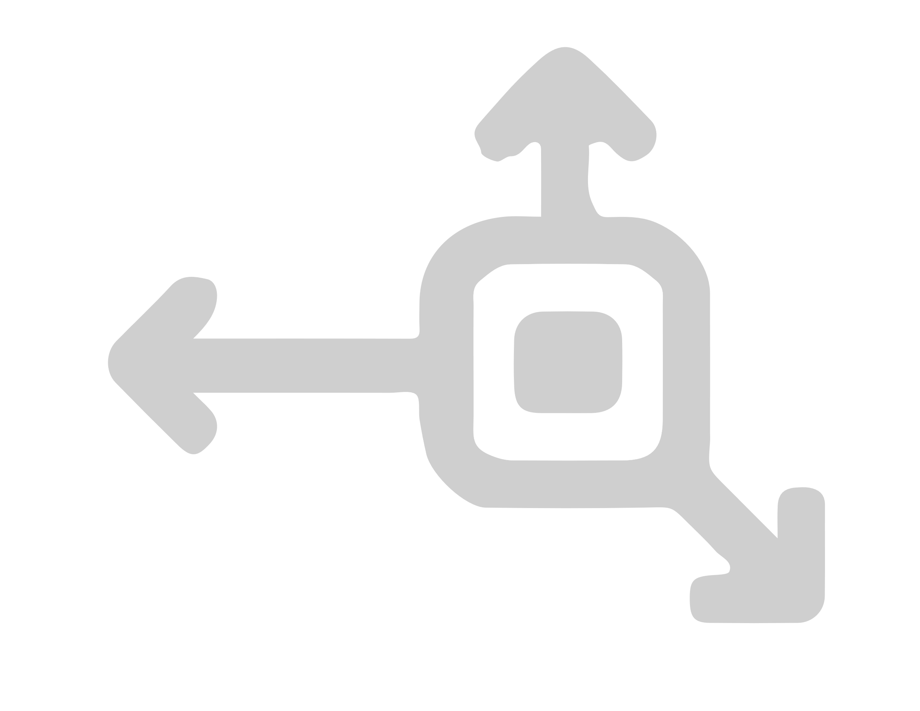







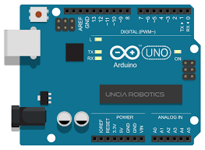
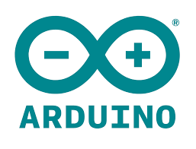
Boards
Sensors/Peripherals
Connection Types
Serial Peripheral Interface
The SPI bus specifies four logic signals:
SCLK: Serial Clock (output from master)
MOSI: Master Out Slave In (data output from master)
MISO: Master In Slave Out (data output from slave)
SS: Slave Select (often active low, output from master)
Accelerometer
Compass
GPS
Universal Asynchronous Receiver-Transmitter
Temperature
Gyroscope
Storage
UART is a computer hardware device for asynchronous serial communication in which the data format and transmission speeds are configurable. It sends data bits one by one, from the least significant to the most significant, framed by start and stop bits so that precise timing is handled by the communication channel.
Heart Rate
Radio Comm
Distance
Analog-to-Digital Converter (ADC)
Inter-Integrated Circuit
In electronics, an analog-to-digital converter (ADC, A/D, or A-to-D) is a system that converts an analog signal into a digital signal. An ADC may also provide an isolated measurement such as an electronic device that converts an input analog voltage or current to a digital number representing the magnitude of the voltage or current. This is how the TMP36 temperature sensor works.
Short for Inter-IC, a type of bus designed by Philips Semiconductors in the early 1980s, which is used to connect integrated circuits (ICs). I2C is a multi-master bus, which means that multiple chips can be connected to the same bus and each one can act as a master by initiating a data transfer.
ARDUINO

Slide 8
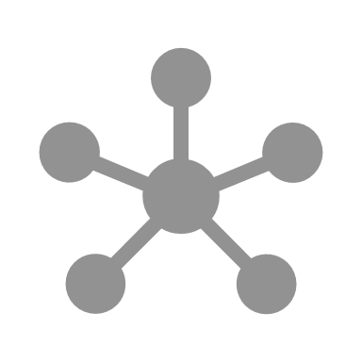

Devices (Things)

Slide 9













Devices (Things)

Slide 10
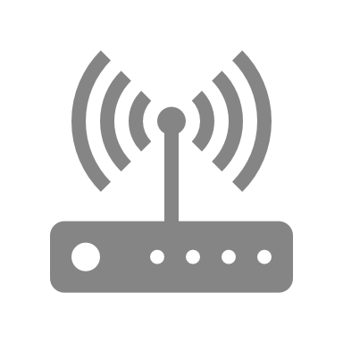
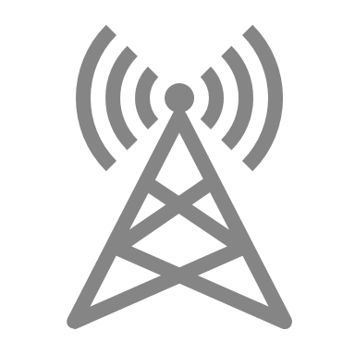

WiFi
cellular
satellite
Devices (Things)
Gateways

Slide 11





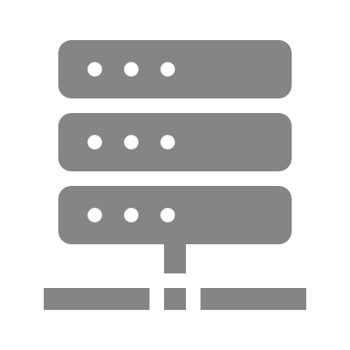
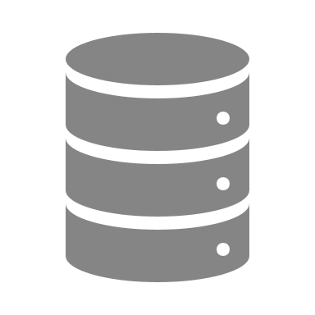

WiFi
cellular
satellite
Devices (Things)
Gateways
IoT Platform

Slide 12







app/user admin
WiFi
rules engine
rest API
calendar
email
message parser
cellular
filter/analysis
microservices
cloud
database
web apps
dashboards
satellite
device mgmt
comm mgmt
Devices (Things)
Gateways
IoT Platform
Applications
Credit: Tamboli @Apress Publishing 2019
Notes:
Devices:
Physical sensors and actuators.
Measure parameters and translate them into electrical or digital data.
Deliver full functionality by acting as inputs, outputs or both
Gateways:
Edge devices that can communicate with the upstream system in one of two ways: with or without a gateway.
Some devices have the capability to communicate directly over Internet Protocol (IP) using various communication protocols, such as REST, MQTT, AMQP, CoAP, and so forth.
These capabilities are usually a result of integrated communication modules, such as Wi-Fi or GSM chips, which enable a device to connect to network gateways, such as Wi-Fi routers and mobile towers, and communicate with the upstream layer directly. In these cases, routers and mobile towers perform the job of the gateway.
However, not all devices are capable of direct Internet connectivity and do not have the necessary hardware built in. In these cases, they need to piggyback on some other device to help their data get pushed to the upstream layer. Gateways help devices do this.
Usually, hardware gateways are built with dual communication technologies, which enable them to communicate with downstream devices with one type of channel and with upstream layers with another type of channel.
Typical examples of such gateway capabilities include GSM and RF, GSM and Bluetooth, Wi-Fi and Bluetooth, Wi-Fi and XBee, LoRaWAN and Ethernet, and so forth. In some cases, smartphones are used as gateways, which is more prominent with Bluetooth Low Energy (BLE) devices.
In addition to providing a transport mechanism, a gateway can also provide optional functions, such as data segregation, clean up, aggregation, deduplication, and edge computing.
IoT Platform:
An IoT platform is the orchestrator of the whole IoT solution and is often hosted in the cloud.
This block is responsible for communicating with downstream devices and ingesting large amounts of data at a very high speed.
The platform is also responsible for storage of the data in a time series and structured format for further processing and analysis.
Applications:
The front face of the whole solution; it must be presented to the end user in a meaningful way.
These applications are desktop based, mobile based, or both.
Applications also enrich the data from the platform in various ways and present it to the users in a usable format. Additionally, these applications integrate with other systems and applications at the interface level and enable interapplication data exchange.
A typical example of such an operation is inventory-tracking devices equipped with tracking mobile applications tothe users, and the data fed to the ERP system for stock keeping.

Slide 13
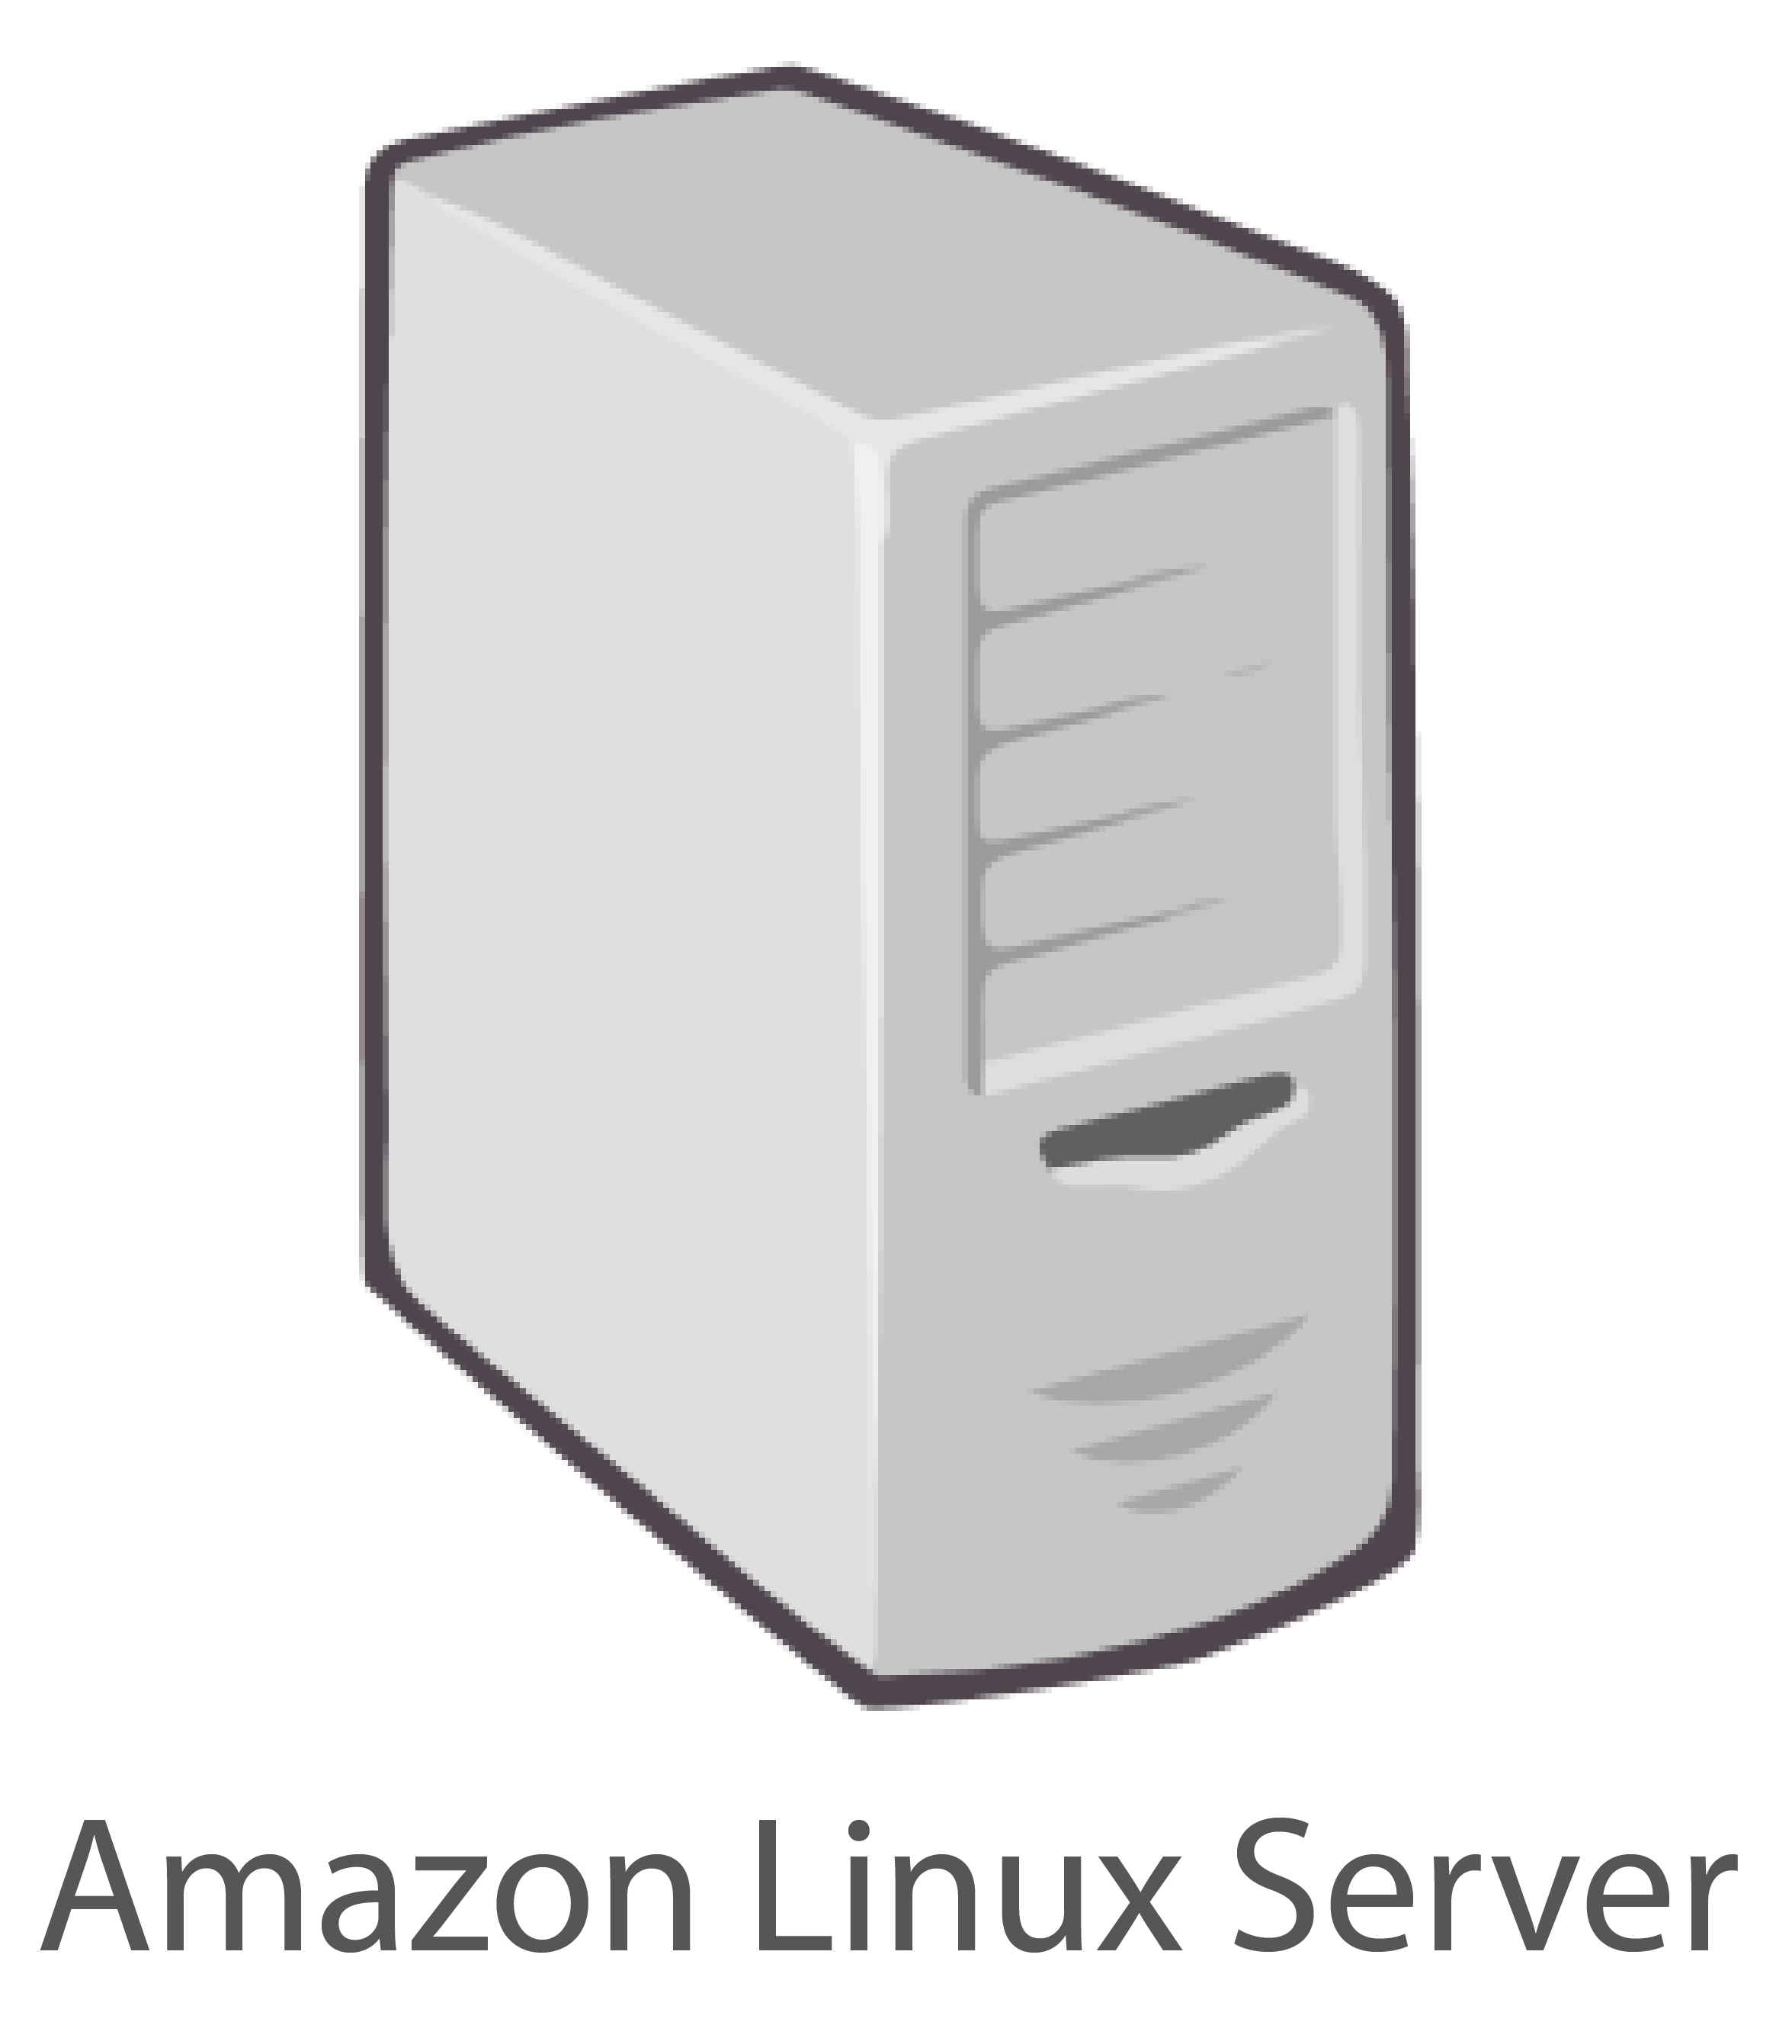

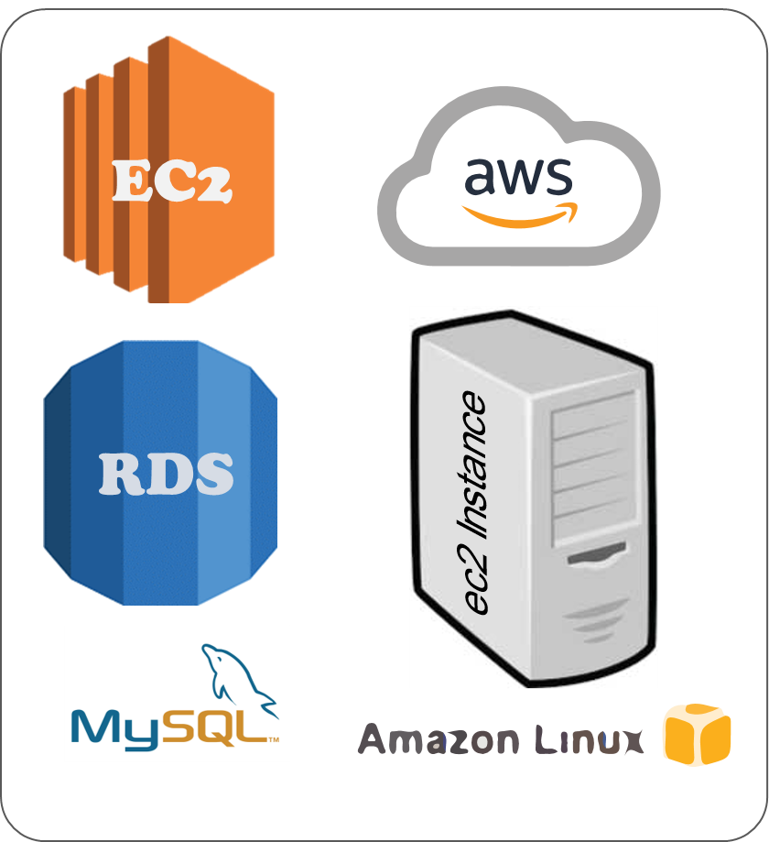


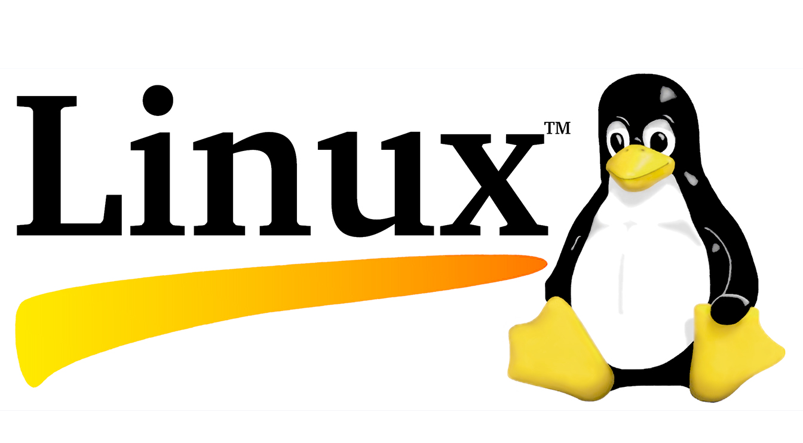

Hardware
Cloud Server
WiFi
calendar
email
MQTT BROKER
cellular
cloud
Software
web apps
dashboards
satellite
Devices (Things)
Gateways
IoT Platform
Applications
Credit: Tamboli @Apress Publishing 2019
Notes:
Devices:
Physical sensors and actuators.
Measure parameters and translate them into electrical or digital data.
Deliver full functionality by acting as inputs, outputs or both
Gateways:
Edge devices that can communicate with the upstream system in one of two ways: with or without a gateway.
Some devices have the capability to communicate directly over Internet Protocol (IP) using various communication protocols, such as REST, MQTT, AMQP, CoAP, and so forth.
These capabilities are usually a result of integrated communication modules, such as Wi-Fi or GSM chips, which enable a device to connect to network gateways, such as Wi-Fi routers and mobile towers, and communicate with the upstream layer directly. In these cases, routers and mobile towers perform the job of the gateway.
However, not all devices are capable of direct Internet connectivity and do not have the necessary hardware built in. In these cases, they need to piggyback on some other device to help their data get pushed to the upstream layer. Gateways help devices do this.
Usually, hardware gateways are built with dual communication technologies, which enable them to communicate with downstream devices with one type of channel and with upstream layers with another type of channel.
Typical examples of such gateway capabilities include GSM and RF, GSM and Bluetooth, Wi-Fi and Bluetooth, Wi-Fi and XBee, LoRaWAN and Ethernet, and so forth. In some cases, smartphones are used as gateways, which is more prominent with Bluetooth Low Energy (BLE) devices.
In addition to providing a transport mechanism, a gateway can also provide optional functions, such as data segregation, clean up, aggregation, deduplication, and edge computing.
IoT Platform:
An IoT platform is the orchestrator of the whole IoT solution and is often hosted in the cloud.
This block is responsible for communicating with downstream devices and ingesting large amounts of data at a very high speed.
The platform is also responsible for storage of the data in a time series and structured format for further processing and analysis.
Applications:
The front face of the whole solution; it must be presented to the end user in a meaningful way.
These applications are desktop based, mobile based, or both.
Applications also enrich the data from the platform in various ways and present it to the users in a usable format. Additionally, these applications integrate with other systems and applications at the interface level and enable interapplication data exchange.
A typical example of such an operation is inventory-tracking devices equipped with tracking mobile applications tothe users, and the data fed to the ERP system for stock keeping.

Slide 14
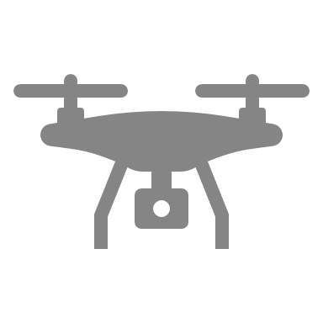

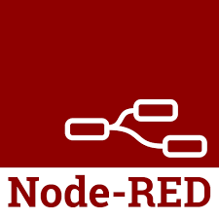

Hardware
Cloud Server
WiFi
calendar
email
Drone Delivery
MQTT BROKER
cellular
cloud
Software
web apps
dashboards
Fire Monitoring
satellite
Devices (Things)
Gateways
IoT Platform
Applications
Credit: Tamboli @Apress Publishing 2019
Notes:
Devices:
Physical sensors and actuators.
Measure parameters and translate them into electrical or digital data.
Deliver full functionality by acting as inputs, outputs or both
Gateways:
Edge devices that can communicate with the upstream system in one of two ways: with or without a gateway.
Some devices have the capability to communicate directly over Internet Protocol (IP) using various communication protocols, such as REST, MQTT, AMQP, CoAP, and so forth.
These capabilities are usually a result of integrated communication modules, such as Wi-Fi or GSM chips, which enable a device to connect to network gateways, such as Wi-Fi routers and mobile towers, and communicate with the upstream layer directly. In these cases, routers and mobile towers perform the job of the gateway.
However, not all devices are capable of direct Internet connectivity and do not have the necessary hardware built in. In these cases, they need to piggyback on some other device to help their data get pushed to the upstream layer. Gateways help devices do this.
Usually, hardware gateways are built with dual communication technologies, which enable them to communicate with downstream devices with one type of channel and with upstream layers with another type of channel.
Typical examples of such gateway capabilities include GSM and RF, GSM and Bluetooth, Wi-Fi and Bluetooth, Wi-Fi and XBee, LoRaWAN and Ethernet, and so forth. In some cases, smartphones are used as gateways, which is more prominent with Bluetooth Low Energy (BLE) devices.
In addition to providing a transport mechanism, a gateway can also provide optional functions, such as data segregation, clean up, aggregation, deduplication, and edge computing.
IoT Platform:
An IoT platform is the orchestrator of the whole IoT solution and is often hosted in the cloud.
This block is responsible for communicating with downstream devices and ingesting large amounts of data at a very high speed.
The platform is also responsible for storage of the data in a time series and structured format for further processing and analysis.
Applications:
The front face of the whole solution; it must be presented to the end user in a meaningful way.
These applications are desktop based, mobile based, or both.
Applications also enrich the data from the platform in various ways and present it to the users in a usable format. Additionally, these applications integrate with other systems and applications at the interface level and enable interapplication data exchange.
A typical example of such an operation is inventory-tracking devices equipped with tracking mobile applications tothe users, and the data fed to the ERP system for stock keeping.

Slide 15


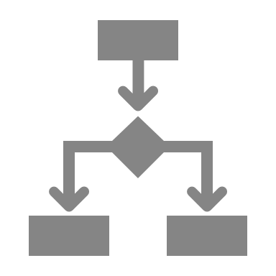

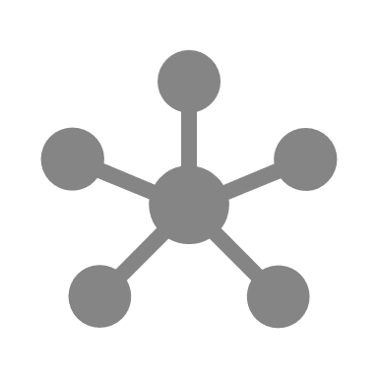
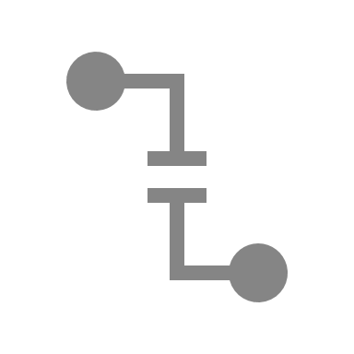
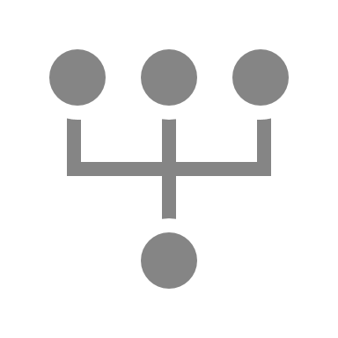



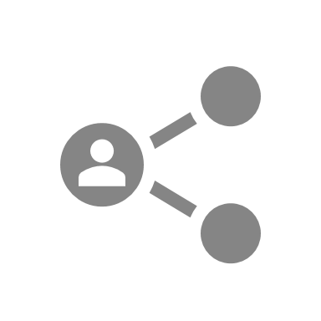

IoT Platform
Time-series
Storage and Data
Management
Device
Management
Rules Engine
Message Router &
Communication
Management
Microservices
Edge Interface
Message Broker
Message Bus
ReST API Interface
Application and
User Management
Credit: Tamboli @Apress Publishing 2019
Devices / Things – Applications – Other Systems
Notes:
Edge Interface, Message Broker, and Message Bus
This module deals and talks with the physical world, especially
heterogeneous devices and sensors. Since devices could be
communicating over a multitude of communication technologies, such
as Wi-Fi, Bluetooth, LoRaWAN, GPRS, and so forth, this module needs
to cater to all of them. We can achieve this in a modular format were
each type of communication protocol is dealt with separately. As an
example, a Wi-Fi-capable device can be a REST API, which caters to the
constrained devices. It could be an MQTT-based message broker, which
enables communication in a pub/sub manner. For LoRaWAN (Long Range
Wide Area Network)–based devices, there is another plugin to the main
message broker, which talks with LoRaWAN network servers and performs
decoding of packets.
This module decouples the entire platform from devices in an effective
way. Many edge interfaces and protocols are supported for modern IoT
devices. Regardless of the medium of communication, network type used,
and protocols in play, the message broker’s job is to consolidate the data
in a unified manner and push it to the common message bus. All the other
functional blocks share this message bus for further operation. The broker
acts as a coordinator and consolidator of messages.

Slide 16
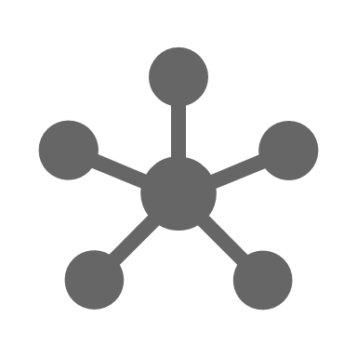
IoT Platform
Time-series
Storage and Data
Management
Device
Management
Rules Engine
Message Router &
Communication
Management
Microservices
Edge Interface
Message Broker
Message Bus
ReST API Interface
Application and
User Management
Credit: Tamboli @Apress Publishing 2019
Devices / Things – Applications – Other Systems
Notes:
Edge Interface, Message Broker, and Message Bus
This module deals and talks with the physical world, especially
heterogeneous devices and sensors. Since devices could be
communicating over a multitude of communication technologies, such
as Wi-Fi, Bluetooth, LoRaWAN, GPRS, and so forth, this module needs
to cater to all of them. We can achieve this in a modular format were
each type of communication protocol is dealt with separately. As an
example, a Wi-Fi-capable device can be a REST API, which caters to the
constrained devices. It could be an MQTT-based message broker, which
enables communication in a pub/sub manner. For LoRaWAN (Long Range
Wide Area Network)–based devices, there is another plugin to the main
message broker, which talks with LoRaWAN network servers and performs
decoding of packets.
This module decouples the entire platform from devices in an effective
way. Many edge interfaces and protocols are supported for modern IoT
devices. Regardless of the medium of communication, network type used,
and protocols in play, the message broker’s job is to consolidate the data
in a unified manner and push it to the common message bus. All the other
functional blocks share this message bus for further operation. The broker
acts as a coordinator and consolidator of messages.

Slide 17

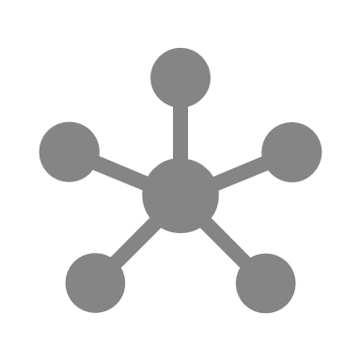
IoT Platform
Time-series
Storage and Data
Management
Device
Management
Rules Engine
Message Router &
Communication
Management
Microservices
Edge Interface
Message Broker
Message Bus
ReST API Interface
Application and
User Management
Credit: Tamboli @Apress Publishing 2019
Devices / Things – Applications – Other Systems
Notes:
Message Router and Communication Management – Refinement of packets, conversion of formats, appendment, etc
Once the messages are available on the main message bus, the message
may need to include more context or refinement to be useful to other
modules. Some messages need feature enrichment and additional
information to be appended or added separately, which depends on the
context of the device deployment and application requirements. The
functionality of enriching existing data messages, rebroadcasting them to
the message bus, publishing additional contextual information and other
messages after the main message arrives, and tagging them as appropriate
is the job of the communication management module. Communication
management functions coordinate with the message broker and the rule
engine block and interacts with the device manager, as required.
In addition, the communication management module performs the
duties of format conversions; for example, it translates data from CSV to
JSON, or binary to text format, and so forth. We can also task it to perform
certain operations, like deduplication of messages. Deduplication is
the process of eliminating or discarding multiple duplicate messages
or redundant data packets from the devices, as they may not be of any
use. Deduplication schemes are dependent on device or sensor types,
and we need to implement them on a case-by-case basis, although the
methodology remains the same. As a communications router, this module
can control further messaging and communication on the platform.

Slide 18
IoT Platform
Time-series
Storage and Data
Management
Device
Management
Rules Engine
Message Router &
Communication
Management
Microservices
Edge Interface
Message Broker
Message Bus
ReST API Interface
Application and
User Management
Credit: Tamboli @Apress Publishing 2019
Devices / Things – Applications – Other Systems
Notes:
Time-Series Storage and Data Management
As the name suggests, this block stores all the received and parsed data
that is available on the message bus in sequential (i.e., time-series style).
While data storage is not the core function of the IoT platform, modules
outside the platform handle it; although, it is an essential activity for
coordination and orchestration perspective. Very often, communication
and routing modules, or the message broker itself, need recent data for
specific functional purposes; this storage comes in handy for all such
instances.
For many IoT applications, users prefer to extract the data away from
the IoT platform and store it in an application data warehouse for further
processing. Therefore, it is often utilized for interim storage of the device
data and is not meant for large-sized dataset storage.

Slide 19
IoT Platform
Time-series
Storage and Data
Management
Device
Management
Rules Engine
Message Router &
Communication
Management
Microservices
Edge Interface
Message Broker
Message Bus
ReST API Interface
Application and
User Management
Credit: Tamboli @Apress Publishing 2019
Devices / Things – Applications – Other Systems
Notes:
Rule Engine
In my view, this is a very powerful block and provides enhanced
capabilities to the platform. The rule engine is the execution block that
monitors the message bus and events across the platform and takes action
based on set rules.
For example, a typical rule engine function may look like this: “Trigger
and broadcast alert message when the downstream device sends a data
packet containing the keyword ka-boom.” The rule engine is constantly
listening to the message bus broadcasts. When the communication block
puts up a decoded data packet from the downstream device on to the
message bus, a rule will trigger. The rule engine broadcasts another message
(alert) to the message bus. Since this happens all within the IoT platform
and among closely coordinated modules, execution speed is quite fast.
The rule engine also helps with building modular rules for decoding and
enriching existing or received data from devices, and therefore, augments
the communication module’s functionality. In addition to that, it is easy to
implement callbacks to other modules, applications, programs, and systems.

Slide 20
IoT Platform
Time-series
Storage and Data
Management
Device
Management
Rules Engine
Message Router &
Communication
Management
Microservices
Edge Interface
Message Broker
Message Bus
ReST API Interface
Application and
User Management
Credit: Tamboli @Apress Publishing 2019
Devices / Things – Applications – Other Systems
Notes:
The REST API Interface
Restful APIs are useful for support functions and utilities that do not need
constant or real-time connectivity and access. Although typically used by
upstream programs and applications, downstream devices can also access
these APIs when needed.
A classic example of such a use case is a temperature sensor with Wi-Fi___
33 connectivity that sends readings every 15 minutes. Due to such a
long time between two subsequent readings, a real-time connection or an
always-on connectivity is undesired. A simple HTTP operation can do the
data-sending job relatively more efficiently. In this case, the sensor can
send the data over REST API to the platform. The REST API works with the
message broker and communications manager to present the received
data post to the main message bus; it may also use time-series database
records to send back the response to the sensor. This response may contain
additional information for the sensor to do its job in a certain way for the next round.
This API block can also support data aggregation and bulk
operational functionalities, such as querying multiple records by the
upstream application. This way, upstream applications and systems
remain decoupled from the core platform blocks, thereby maintaining
the partition of functions and ensuring security. Various role-based
authentications can be built in for access to the API.
The REST API block can also feed into the rule engine and allow
applications to configure or trigger specific rules at any given point in
time. This also makes it possible for downstream devices to utilize the
same functionality, which could be handy when devices need to initiate
certain workflows automatically in place of application triggers. A good
example is a smart lock; for instance, when there is activity at the front
door that needs the homeowner’s attention when she is away from home.
An upstream application may notify the user when the smart lock reports
activity, and then expects the user to respond or react for further steps.
If the user is not available, then the application can trigger the rule for
predefined actions. If the severity of the alert is relatively high, then the
device may be configured to not wait for user action or response, but
directly trigger the default workflow (e.g., notifying security, etc.). These
functionalities can come in handy when designing and operating an
autonomous and intelligent fleet of devices.

Slide 21
IoT Platform
Time-series
Storage and Data
Management
Device
Management
Rules Engine
Message Router &
Communication
Management
Microservices
Edge Interface
Message Broker
Message Bus
ReST API Interface
Application and
User Management
Credit: Tamboli @Apress Publishing 2019
Devices / Things – Applications – Other Systems
Notes:
Microservices
Besides data management, manipulation, and exchange functionalities,
the IoT platform also needs certain support functions to function effectively.
Services such as text messaging or email notifications, verifications, captcha,
social media authentications, or payment services integration are a few examples
of these auxiliary services. These services are bundled in the microservices block.
In case of frequent use of certain functionalities within the platform,
it can be bundled and packaged under this block to separate it from
the mainstream platform. Once separated and packaged, it then can be
exposed to the blocks within and outside the platform for reuse.

Slide 22
IoT Platform
Time-series
Storage and Data
Management
Device
Management
Rules Engine
Message Router &
Communication
Management
Microservices
Edge Interface
Message Broker
Message Bus
ReST API Interface
Application and
User Management
Credit: Tamboli @Apress Publishing 2019
Devices / Things – Applications – Other Systems
Notes:
Device Manager
When the platform starts to host approximately 50 or more devices, things
could become difficult to manage. It becomes necessary to have some
type of central control in place for managing things (a.k.a. devices). This is
where the device manager block helps. It essentially provides the generic
functionality of managing devices as assets. This includes listing all the
devices, their active-inactive status, battery levels, network conditions,
access keys, readings, stored data access, device details, session
information, and other similar things.
The device manager also helps with managing over-the-air updates
for a fleet of devices, or central monitoring functions for system admins.
In certain use cases, devices also need access rights, and users may be
assigned certain access rights to a set of devices. Management of such an
accessibility matrix becomes easy with the device manager.

Slide 23
IoT Platform
Time-series
Storage and Data
Management
Device
Management
Rules Engine
Message Router &
Communication
Management
Microservices
Edge Interface
Message Broker
Message Bus
ReST API Interface
Application and
User Management
Credit: Tamboli @Apress Publishing 2019
Devices / Things – Applications – Other Systems
Notes:
Application and User Management
This block provides functionalities similar to the device manager. The
difference is that it provides functionalities for upstream applications
and users. Typical user management functions, such as passwords and
credentials, access keys, logins, and rights are managed through this block.
For upstream applications and various other integrated systems, API keys,
credentials, and access can be managed through the same block.
While it may appear to be more of an application-level functionality,
it remains in an IoT platform’s interest to bind it as a platform function, so
that it is integrated tightly with the overall architecture and set of things.
IoT is the system of systems, and heterogeneous systems are a fact of this
phenomenon. Letting these system functions get out of sync is the last
thing that you want to happen with IoT solutions.

Slide 24
Device Communication Protocols
1. MQTT - Message Queuing Telemetry Transport
2. HTTP Requests – GET and POST
3. AJAX – Asynchronous JavaScript and XML

Slide 25
Device Communication Protocols
1. MQTT - Message Queuing Telemetry Transport
2. HTTP Requests – GET and POST
3. AJAX – Asynchronous JavaScript and XML

Slide 26

Message Queuing Telemetry Transport
MQTT is an open OASIS and ISO standard
Lightweight publish-subscribe network protocol that transports messages between constrained devices & server apps
It keeps bandwidth requirements to an absolute minimum
Efficient in unreliable networks
Requires little implementation effort for developers
Ideal for machine-to-machine (M2M) communication
Notes:
MQTT is an OASIS standard messaging protocol for the Internet of Things (IoT).
OASIS is a not-for-profit consortium that brings people together to agree on intelligent ways to exchange information over the Internet and within their organizations.
It is designed as an extremely lightweight publish/subscribe messaging transport that is ideal for connecting remote devices with a small code footprint and minimal network bandwidth.
MQTT today is used in a wide variety of industries, such as automotive, manufacturing, telecommunications, oil and gas, etc.

Slide 27

Message Queuing Telemetry Transport
MQTT Packet has Two Parts:
Topic
/node1/esp32/gps/records
Message (payload – usually as JSON)
{ “latitude” : 38.12345, “longitude” : -78.12345 }
MQTT BROKER
https://test.mosquitto.org/
Notes:
MQTT is an OASIS standard messaging protocol for the Internet of Things (IoT).
OASIS is a not-for-profit consortium that brings people together to agree on intelligent ways to exchange information over the Internet and within their organizations.
It is designed as an extremely lightweight publish/subscribe messaging transport that is ideal for connecting remote devices with a small code footprint and minimal network bandwidth.
MQTT today is used in a wide variety of industries, such as automotive, manufacturing, telecommunications, oil and gas, etc.

Slide 28
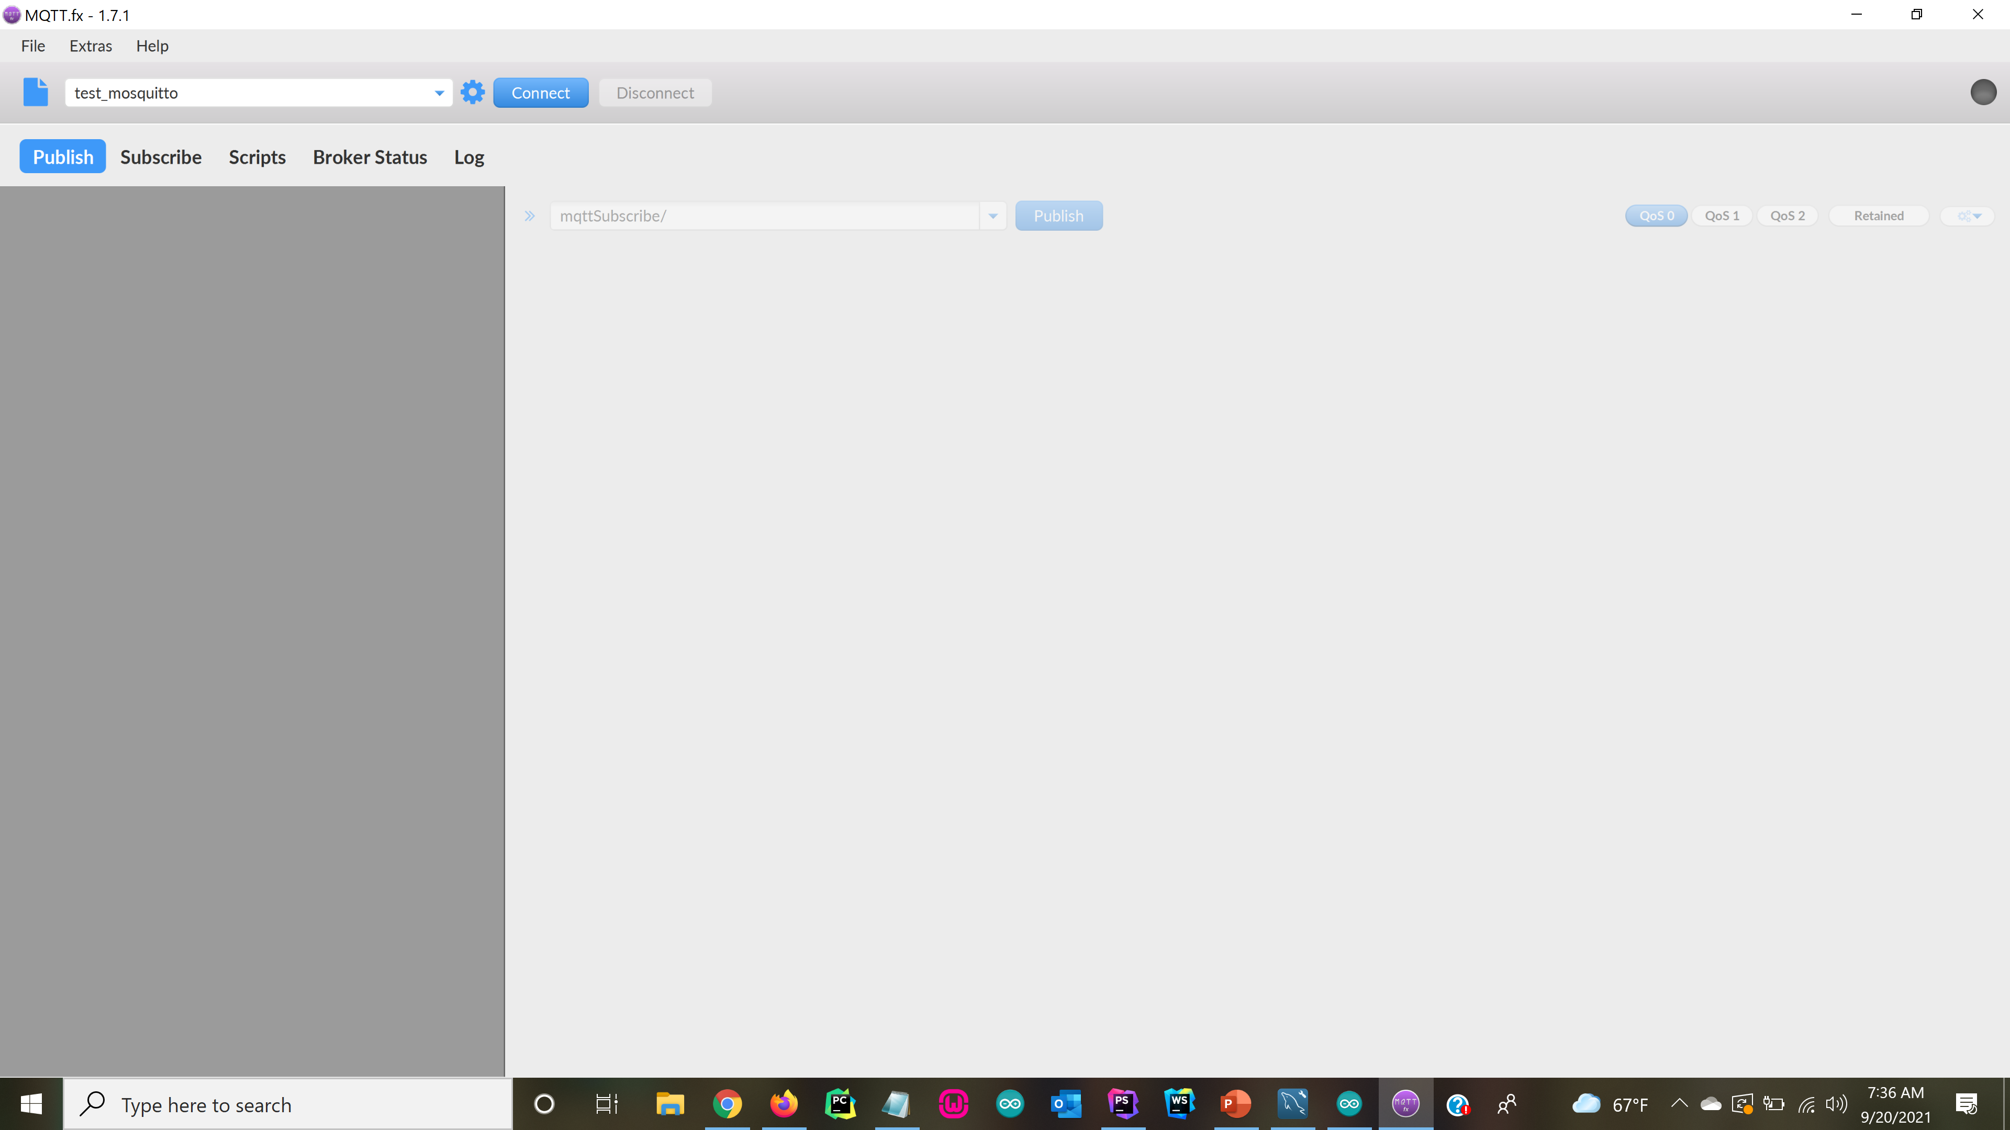
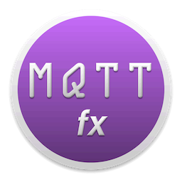
Open MQTT.fx
Notes:
Exercise One: Have students open MQTT.fx and send each other messages.

Slide 29
What is JSON? - JSON - JavaScript Object Notation
JSON is a lightweight data-interchange format.
It is easy for humans to read and write.
It is easy for machines to parse and generate.
Example of JSON
'{ "latitude":"38.12345", "longitude":"-78.12345", "hdop":1.80, "temperature": 68.2 }'
JSON is built on two structures:
A collection of key/value pairs. In various languages, this is realized as an:
2. An ordered list of values or array. Virtually all modern programming languages support them in
one form or another. It makes sense that a data format that is interchangeable with programming
languages also be based on these structures.
object, dictionary, hash table, keyed list, or associative array.
Notes:
PhpStorm NodeJS REPL demo

Slide 30






Payload
{
“light” : “1”,
“status” : “off”
}
Publish
Topic
Subscribe
light_switch /
GUI Interface on Web Application
Payload
{
“light” : “1”,
“status” : “on”
}
light_switch /

Slide 31
Payload
{
“light” : “1”,
“status” : “on”
}
Light 1
Payload
Publish
Topic
Subscribe
{
“light” : “2”,
“status” : “on”
}
GUI Interface on Web Application
light_switch /
Light 2
Payload
{
“light” : “3”,
“status” : “on”
}
Light 3
light_switch /

Slide 32
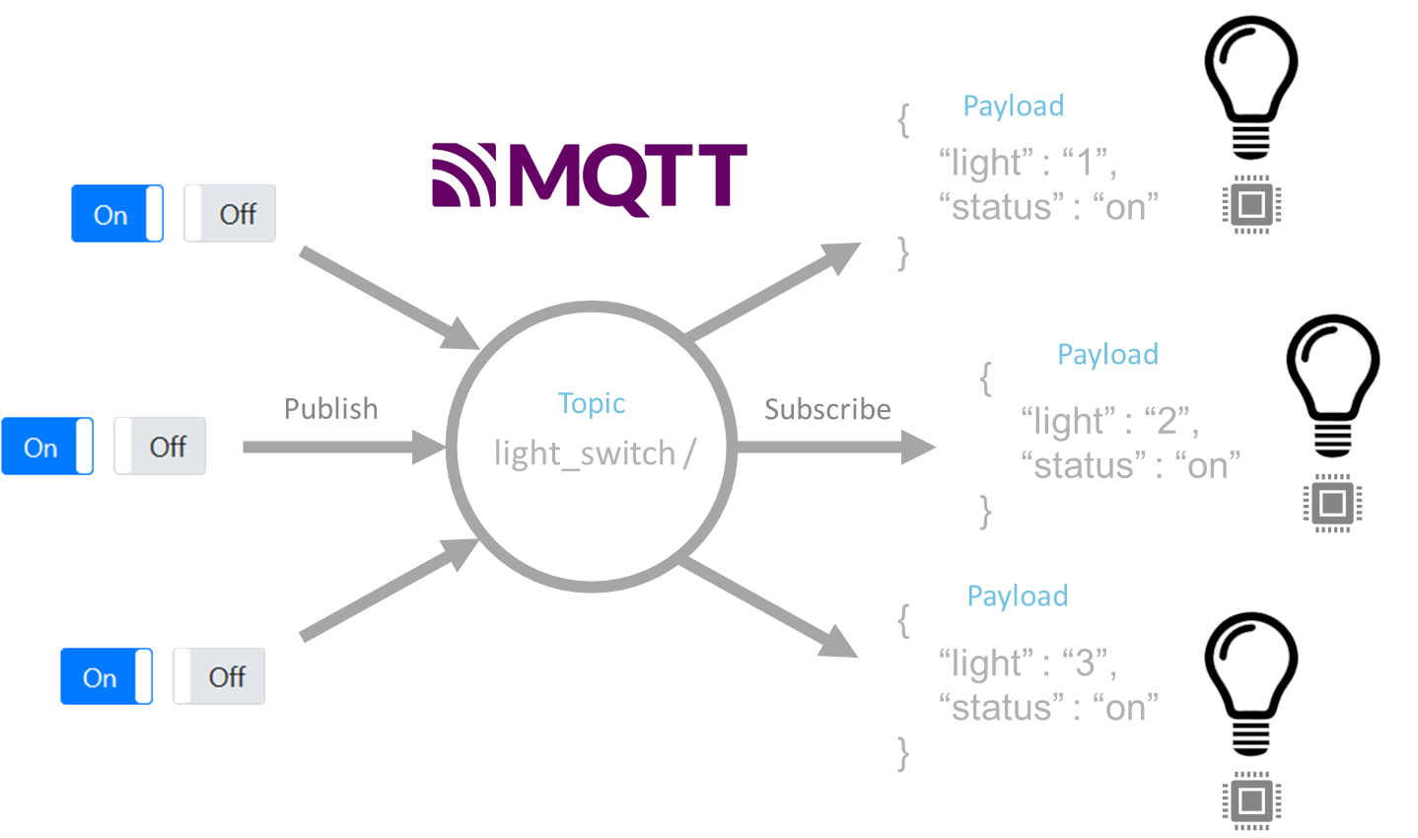

Room One
Room Two
light_switch /
light_switch2 /

Slide 33




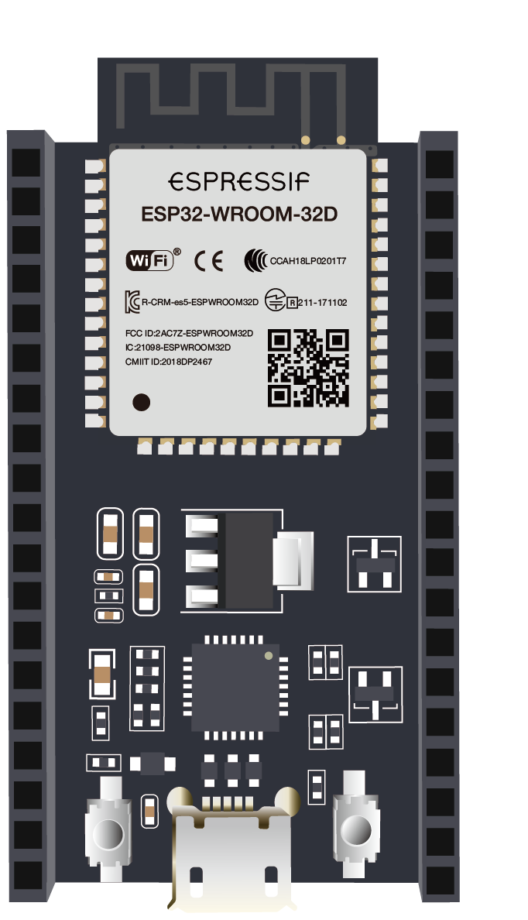


#include <PubSubClient.h>
MQTT BROKER
TOPIC
Sub
mqttSubscribe/
Publish
Web Application
Dashboard
PAYLOAD
{ “light”: 1, “status”: “On” }
digitalWrite(LED_PIN, HIGH);
{ “light”: 1, “status”: “Off” }
digitalWrite(LED_PIN, LOW);
Notes:
MQTT is an OASIS standard messaging protocol for the Internet of Things (IoT).
OASIS is a not-for-profit consortium that brings people together to agree on intelligent ways to exchange information over the Internet and within their organizations.
It is designed as an extremely lightweight publish/subscribe messaging transport that is ideal for connecting remote devices with a small code footprint and minimal network bandwidth.
MQTT today is used in a wide variety of industries, such as automotive, manufacturing, telecommunications, oil and gas, etc.

Slide 34
#include <PubSubClient.h>
MQTT BROKER
TOPIC
Publish
/iot2020/ESP_TEAM1/serialdata/tx
Sub
Web Application
Dashboard
PAYLOAD
64.2
{ “teamID”: 1, “temp”: 64.2 }
Notes:
MQTT is an OASIS standard messaging protocol for the Internet of Things (IoT).
OASIS is a not-for-profit consortium that brings people together to agree on intelligent ways to exchange information over the Internet and within their organizations.
It is designed as an extremely lightweight publish/subscribe messaging transport that is ideal for connecting remote devices with a small code footprint and minimal network bandwidth.
MQTT today is used in a wide variety of industries, such as automotive, manufacturing, telecommunications, oil and gas, etc.

Slide 35
Wiring the ESP32 – Connect LED and TMP36 Temperature Sensor
Get TMP36 Temperature Sensor Connected and Outputting Temperature Data
Sketch => ESP32_ADC_Reading_TMP36_TemperatureSensor.ino
Turning LED On and OFF using ESP32
Sketch => LED_Blink_ESP32_Pin5
Understanding JSON (node demo) using PhpStorm IDE
Understanding JSON using ESP32
Sketch => Understanding_JSON.ino
Understanding Basics of MQTT.fx demo => send each other messages
Understanding MQTT using ESP32 and MQTT.fx
Sketch => MQTT_Basics_IoTNetworking.ino
Notes:
if(!client.connected()) {
reconnect();
}
char charArray[length + 1];
memcpy(charArray, payload, length);
charArray[length] = NULL;
String message(charArray);
JSONVar jsonObject = JSON.parse(message);
jsonObject["teamID"];
jsonObject["message"];
Serial.print("From Handle Light: ");Serial.println(jsonObject["message"]);
const char* lightStatus = jsonObject["message"];
if(String(lightStatus) == "On"){
Serial.println("Yes, light is on!");
}

Slide 36

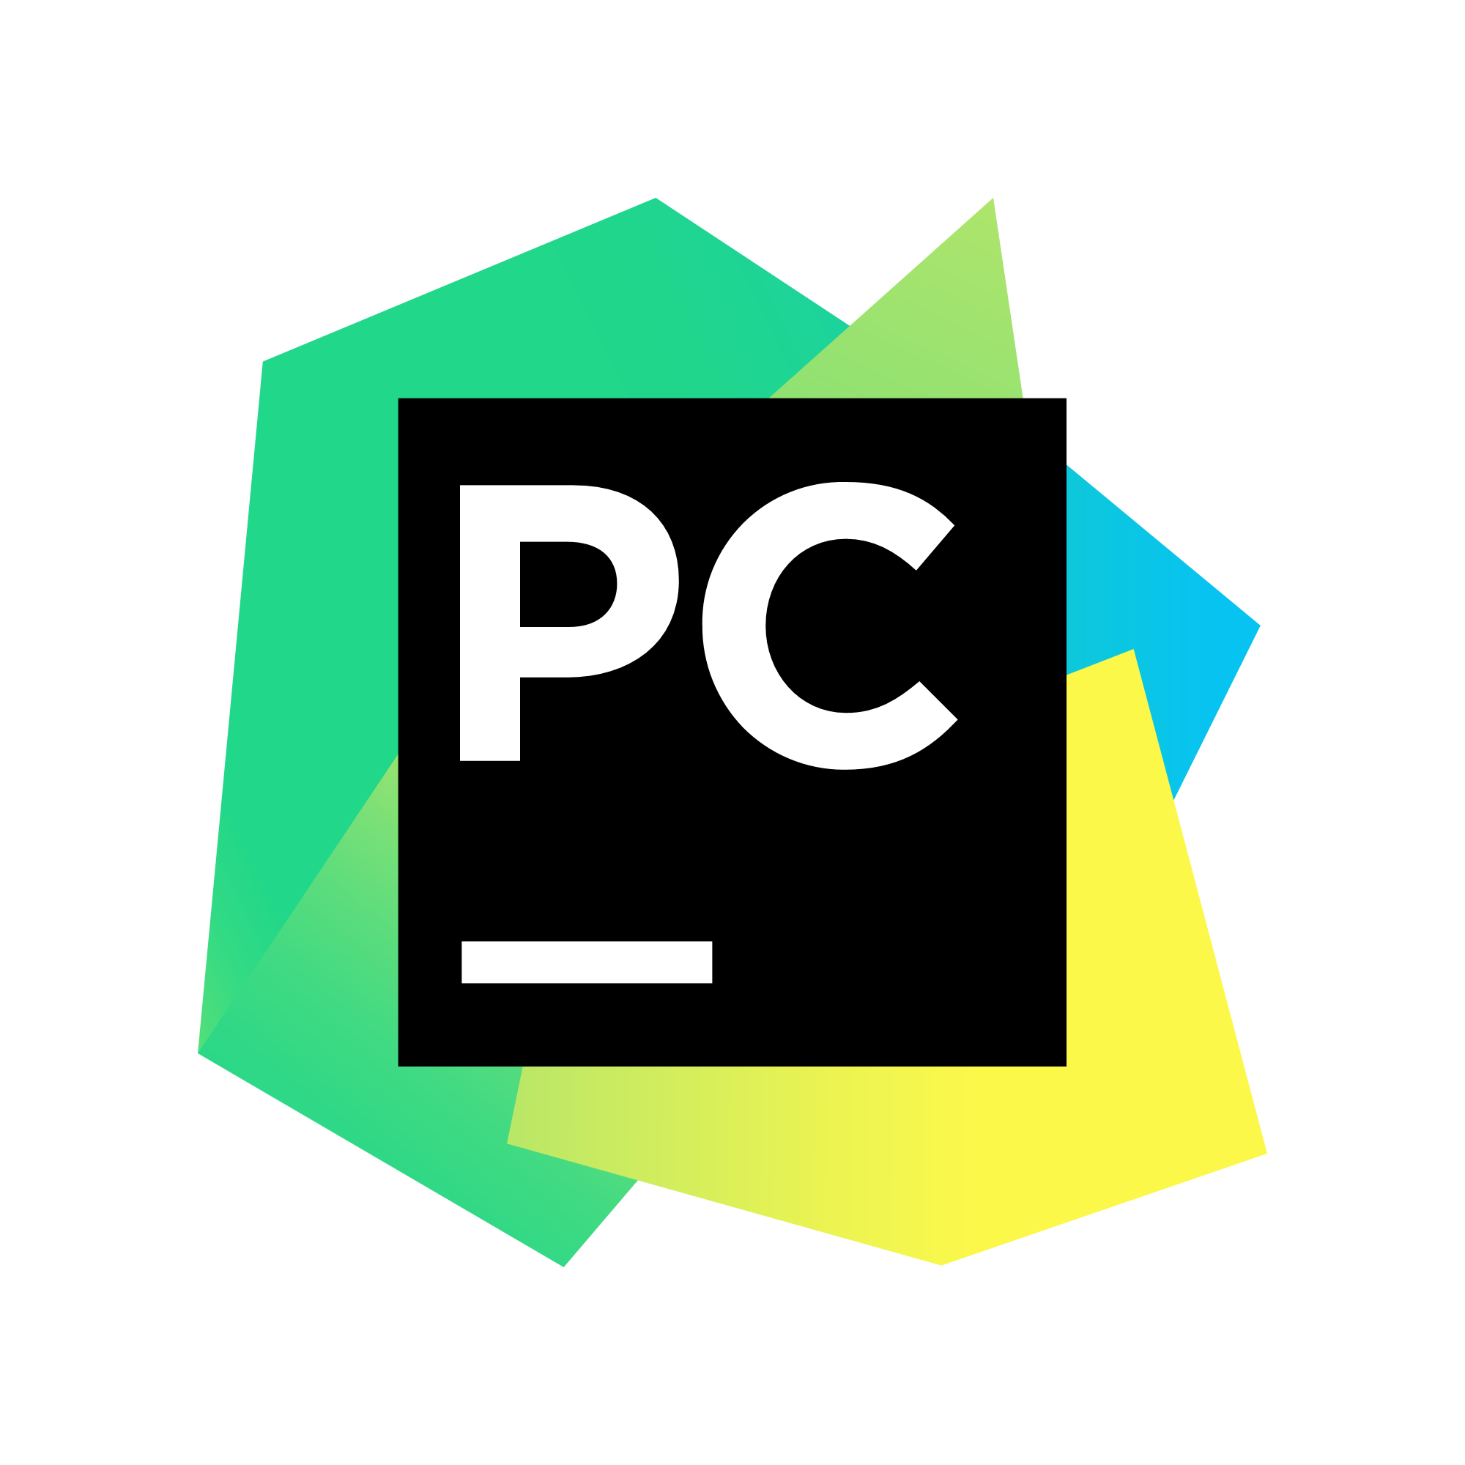



Software Downloads
PhpStorm - JetBrains
MQTT.fx
PyCharm - JetBrains
MySQL Workbench
Postman
Notes:
Secure Shell:
Secure Shell (SSH) is a cryptographic network protocol for operating network
services securely over an unsecured network. Typical applications include remote
command-line, login, and remote command execution, but any network service can be
secured with SSH.
EER Diagram:
Enhanced entity-relationship (EER) diagrams are basically an expanded upon version
of ER diagrams. EER models are helpful tools for designing databases with high-level
models. With their enhanced features, you can plan databases more thoroughly by delving
into the properties and constraints with more precision.
EC2:
Amazon Elastic Compute Cloud (Amazon EC2) is a web service that provides secure, resizable
compute capacity in the cloud. It is designed to make web-scale cloud computing easier for
developers. Amazon EC2’s simple web service interface allows you to obtain and configure
capacity with minimal friction. It provides you with complete control of your computing resources
and lets you run on Amazon’s proven computing environment.
Amazon Relational Database Service (RDS):
Amazon Relational Database Service (Amazon RDS) makes it easy to set up, operate, and scale a
relational database in the cloud. It provides cost-efficient and resizable capacity while automating
time-consuming administration tasks such as hardware provisioning, database setup, patching and
backups. It frees you to focus on your applications so you can give them the fast performance,
high availability, security and compatibility they need.
WAMP:
Stands for "Windows, Apache, MySQL, and PHP." WAMP is a variation of LAMP for Windows systems
and is often installed as a software bundle (Apache, MySQL, and PHP). It is often used for web development
and internal testing but may also be used to serve live websites.
LAMP:
is an open source Web development platform that uses Linux as the operating system, Apache as the Web server,
MySQL as the relational database management system and PHP as the object-oriented scripting language.
(Sometimes Perl or Python is used instead of PHP.)
PhpStorm:
is a commercial, cross-platform IDE (integrated development environment) for PHP, built by the Czech
Republic-based company JetBrains. PhpStorm provides an editor for PHP, HTML and JavaScript with on-the-fly
code analysis, error prevention and automated refactorings for PHP and JavaScript code.

Slide 37
Ten IoT Considerations
Scalability
Reliability
Customization
Supported Protocols and Interfaces
Hardware Agnostic
Cloud Agnostic
Architecture and Technology Stack
Security
Cost
Support
Notes:
The Internet of Things is the network of physical devices, such as appliances, smartphones, vehicles, streetlights, infrastructure elements, industrial machines

